Slide 1
Use of ProMoss™ in Aquariums
CREATIVE WATER SOLUTIONS
Plymouth, MN
www.cwsnaturally.com

Slide 2
History
Started in 2003
Commercialization 2004
Residential Spas
Residential Pools
Commercial Spas
Commercial Pools
Fountains
Ponds
Aquariums
Industrial Water
Homes and Potable Water
Notes:
The company was founded by David Knighton MD and Vance Fiegel with technology developed at Embro Corporation (a research and development firm owned by Knighton and Fiegel.

Slide 3
Why Sphagnum Moss?
David read Atlantic Monthly article during a flight
Article discussed WWI use of Sphagnum moss and increased survival of soldiers with wounds treated topically with Sphagnum moss
Native Americans used Sphagnum moss in wounds and as a diaper
Vikings used Sphagnum moss to treat drinking water and preserve food
The article attributes the increased survival rate to absorption of fluids by dried moss
David hypothesized that the effect could only be attributed to anti-microbial activity
Reviewed medical articles
Vance began laboratory studies
Notes:
How did this all start? David was flying back from Germany and ran out of work over Canada. A nice flight attendant on Northwest Airlines responded to a request for something to read by bringing 3 magazines – Golf Digest, People and the Atlantic. David doesn’t golf (Vance Does) and he doesn’t read People very often. He choose the Atlantic and read a short article about the use of Sphagnum moss as a wound dressing in WWI. Both the English and the Germans discovered that packing soldier’s war wounds with Sphagnum moss resulted in higher survival rates than packing their wounds with cotton. The article attributed this observation to the absorbency of dried Sphagnum moss. The hypothesis that the Moss had to effect bacterial infection to have the documented results stimulated laboratory study in the effect of Sphagnum moss on bacterial growth.

Slide 4
Moss Bogs in the Upper Midwest USA
The land of sky blue waters
Northern Minnesota
Northern Wisconsin
Upper Peninsula of Michigan
South-eastern Canada
Associated with Iron rich soil and water
Notes:
This is a map of the state of Minnesota. The grren areas around Lake Superior, in the northern and eastern part of the state are the areas that contain Sphagnum moss. Northern Wisconsin, Northern Michigan, and southern Ontario also contain large amounts of the correct Sphagnum Moss. The species we use in our product comes from areas where the water and soil are rich in iron.

Slide 5
Boundary Waters Canoe Wilderness
Notes:
The wilderness area in northeastern Minnesota is called the Boundary Waters Canoe Wilderness. This is where “The land of sky blue waters” in the famous Hamm’s beer commercial comes from.

Slide 6
Junction of the Mississippi and St. Croix Rivers
Notes:
This is an aerial picture of the junction of the Mississippi River with the Minnesota River. The Minnesota River is the green strip on the bottom left of the slides and the Mississippi River comes in from the left-hand side of the slide. The Mississippi River contains moss treated water from northern Minnesota and the Minnesota River contains non-moss treated water from the farmlands of Southwest Minnesota. This is nature's example of how effective Sphagnum moss treated water is in clarifying the water.

Slide 7
Transferring Nature’s Miracle to Ponds, Streams and Aquariums
Nature’s Moss Water Treatment
ProMoss™ Water Treatment
Sphagnum moss is alive
Sphagnum moss regenerates water treatment activities
Water flows through the moss bogs in a slow steady stream
Sphagnum treated water flows downstream to affect all the water
ProMoss™ is dead
Dosage is based on one months activity
After one month the leaves are full and have delivered all their molecules to the water
Either the water moves or needs to be pumped to move through ProMoss™

Slide 8
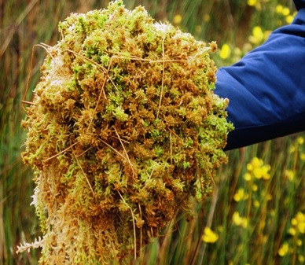
Sphagnum Moss
Harvested by hand
Green
Sustainable
Renewable
Notes:
The Sphagnum Moss used in our products is a natural green plant that grows in bogs. It is harvested by hand so there is no damage to the bog and the root structure of the plant is left in place so it can regrow. It is totally sustainable and renewable.

Slide 9
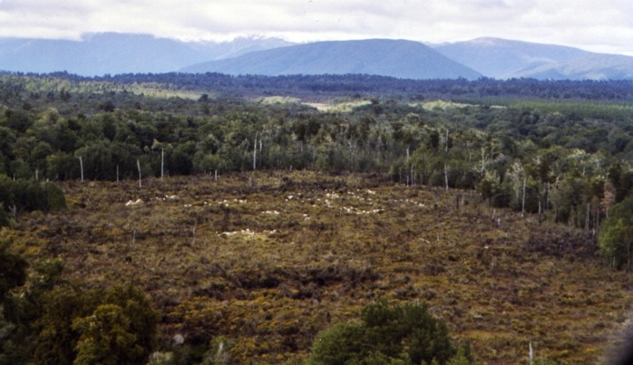
Sphagnum Moss Bog
Notes:
This is a moss bog.

Slide 10
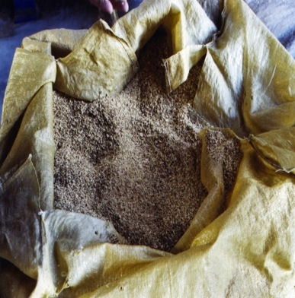
First Step in CWS Product Journey
Select species of Sphagnum moss
Leaves are separated and cleaned
CWS products are made from moss leaves
Notes:
The moss leaves are small and look like oatmeal. CWS products are made from the select species of Sphagnum Moss.

Slide 11
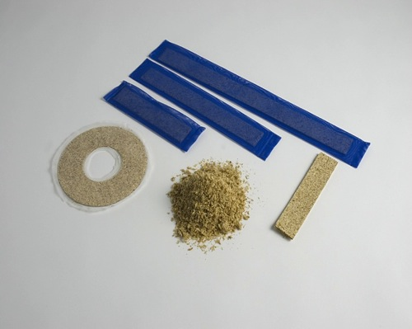
Second Step in CWS Product Journey
Cut and compressed
Leaves are pressed and formed into a board
Boards are cut into correct shapes
Moss is sterilized
Notes:
The leaves are compressed into a board, cut into the desired shape and sterilized

Slide 12
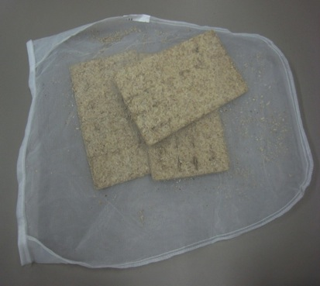
Product for Commercial Applications
Sphagnum moss for commercial and industrial applications
Select species
Patented
Notes:
Commercial applications use Sphagnum Moss compressed into larger blocks and contained in a large fine mesh bag. The products are protected by 3 issued US patents and issued patents in most industrialized countries. More patents are pending.

Slide 13
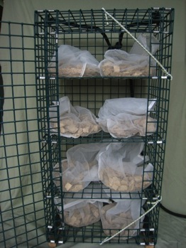
PoolNaturally® Plus
Submerged Contact Chamber
PoolMoss® and ProMoss™ are exposed to water using a contact chamber
Contact chamber is submerged in flowing water
Flow within the tank allows exposure of the PoolMoss® and ProMoss™ leaves to the water
Notes:
ProMoss™ is delivered to the water to be treated in one of two contact chambers. This is the submerged contact chamber that comes in different sizes. This is the largest of the submersible contact chambers with four shelves that contain two bags of ProMoss(tm) each.

Slide 14
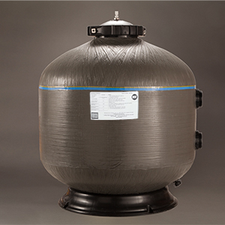
PoolNaturally® Plus
Non-Surge Tank Application
Installed off line
Maintain 15 Gal/min flow
Plumbed across an existing pump or an auxiliary pump
Notes:
When a submersible contact chamber is not feasible or appropriate, we have different size off-line chambers that can contain various amounts of ProMoss™. The flow through this chamber is optimal at 20 gallons per minute and it is installed using an existing pump or with an auxiliary pump to maintain the desired flow. Creative Water Solutions as a pending patent on the internal design of these chambers.

Slide 15
Personal Aquarium Upstate NY
Before ProMoss™
Before ProMoss™

Slide 16
Personal Aquarium Upstate NY
After ProMoss™
After ProMoss™

Slide 17
Freshwater Aquarium Controlled Study
Aquariums divided into two groups
One treated with ProMoss™ at 1 gm per five gallons of water
Both groups treated identically by aquarium staff
Water measured weekly for turbidity, pH, ammonia, nitrite, and nitrate
Ammonia and nitrite levels were 0 in both groups

Slide 18
Aquariums

Slide 19
Aquariums

Slide 20
Number of Fish per Tank

Slide 21
pH

Slide 22
Turbidity

Slide 23
NITRATE

Slide 24
CWS Aquarium Treated With ProMoss™

Slide 25
CWS Aquarium Care
Dosage 1 gm per 5 gallons
25% water exchanged each month with ProMoss™ treated water at room temperature
ProMoss™ changed monthly
Filter cleaned and changed every 2 months
Sides of the tank cleaned once per month
Rocks suctioned once per month

Slide 26
Conclusions
ProMoss™ promotes
Maintains water clarity
Prevents organic contamination growth on
Glass
Plants
Fish
ProMoss™ stabilizes
pH
ProMoss™ reduces
Nitrates
Turbidity

